Slide 1
Week 5 – lesson 1

Slide 2
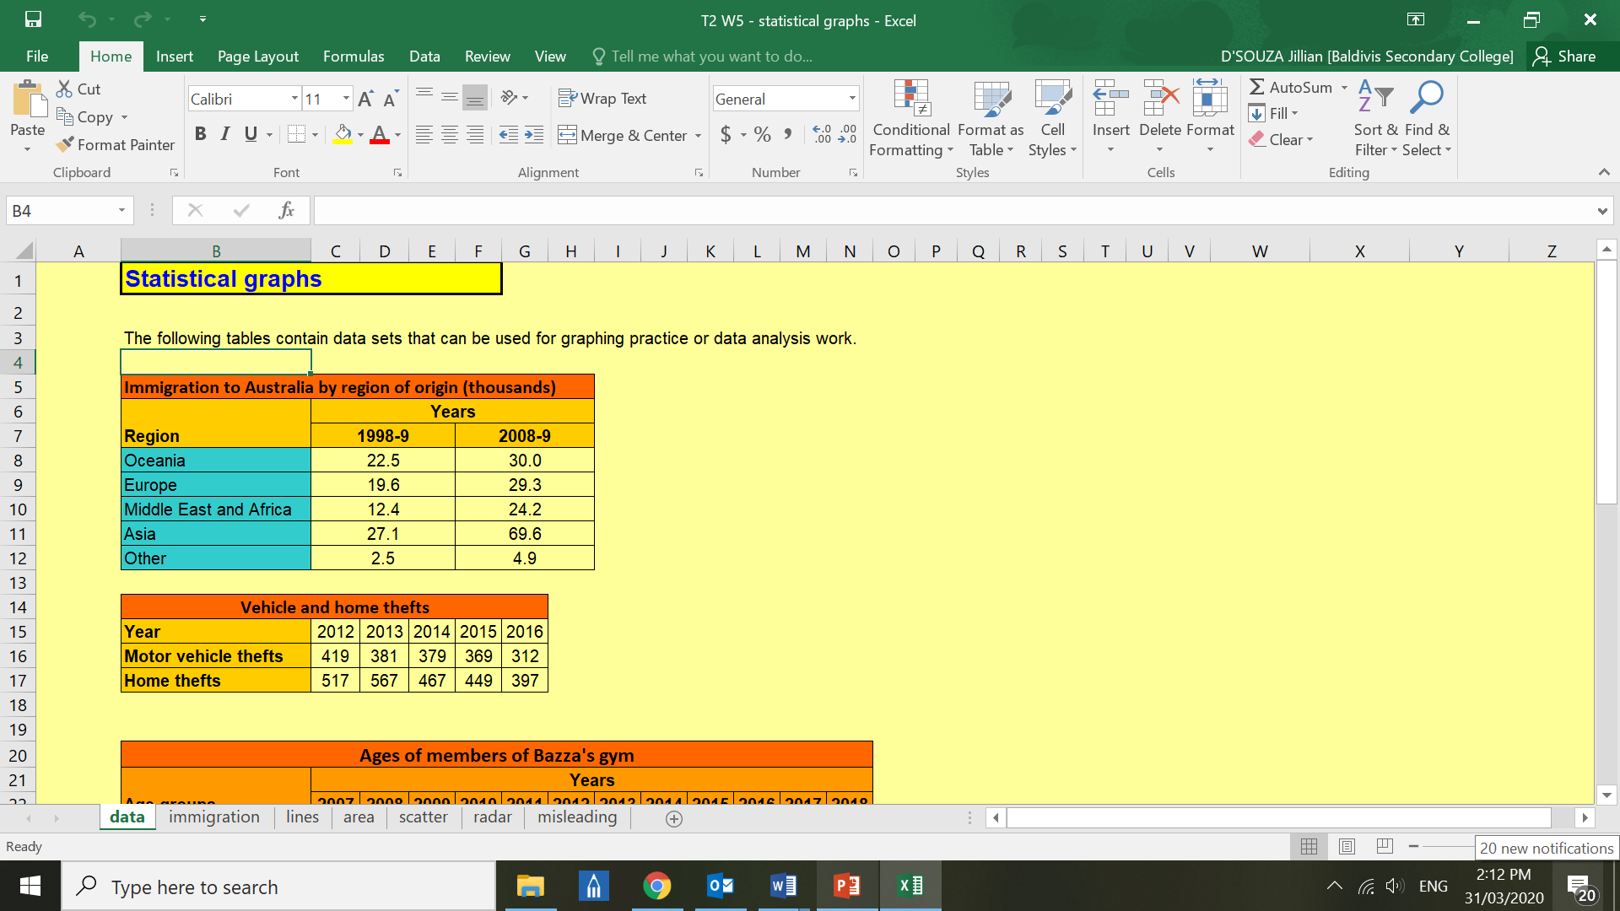
Microsoft Excel ‘Statistical Graphs’

Slide 3
Week 5 – lesson 2

Slide 4
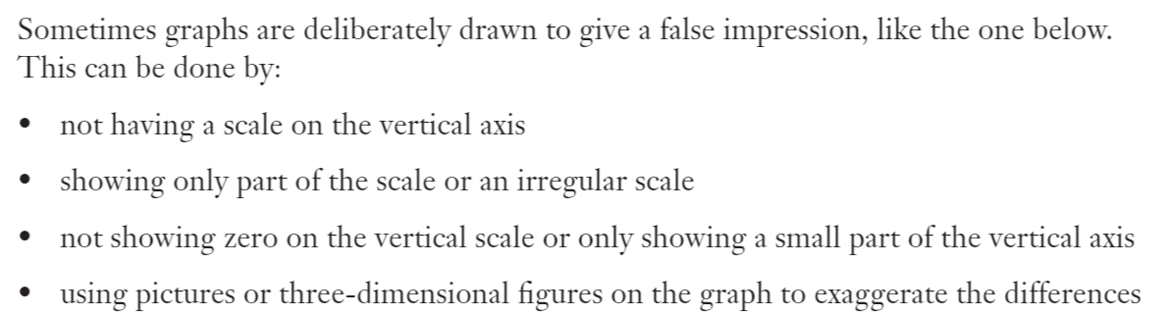
EQ: How can graphs be misleading?
TOPIC: Graphs

Slide 5
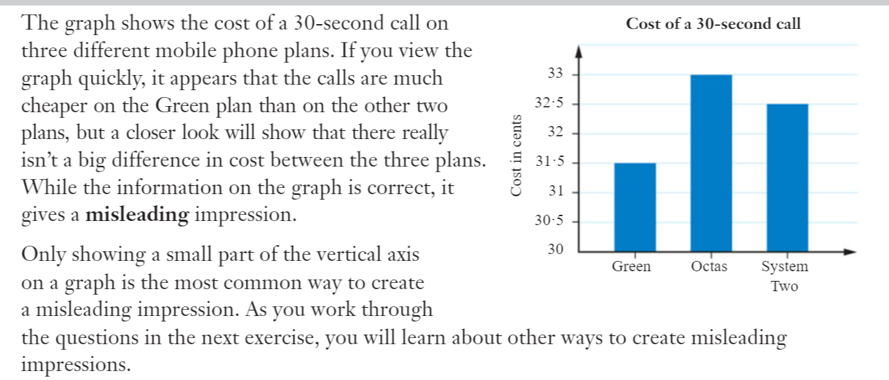

Slide 6
Week 5 – lesson 3

Slide 7
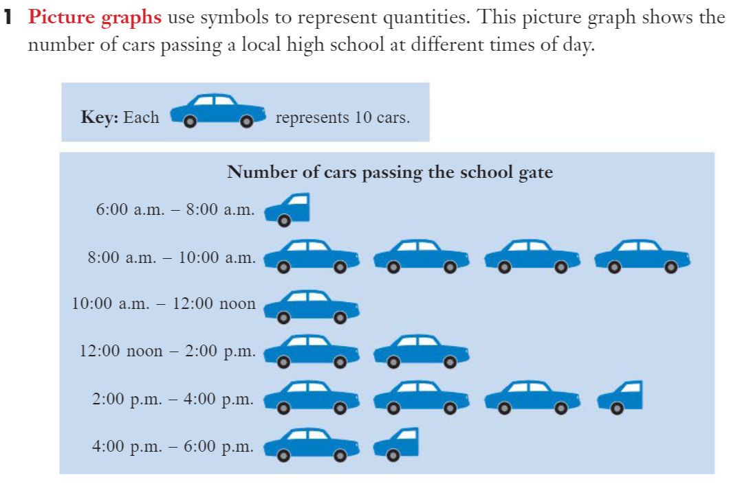

Slide 8
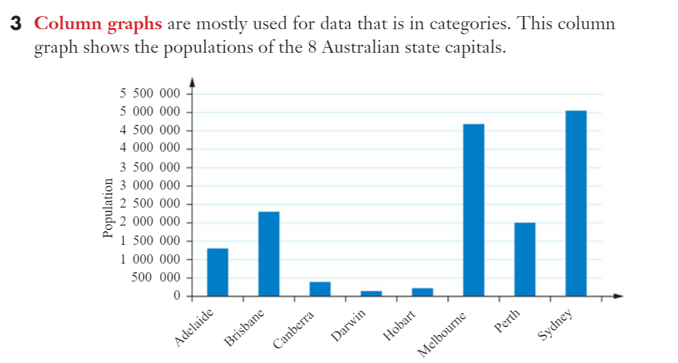

Slide 9
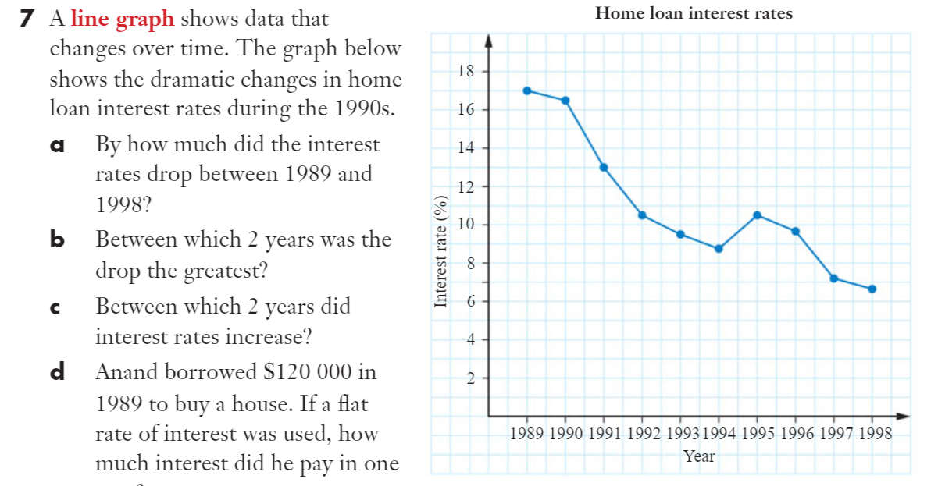

Slide 10
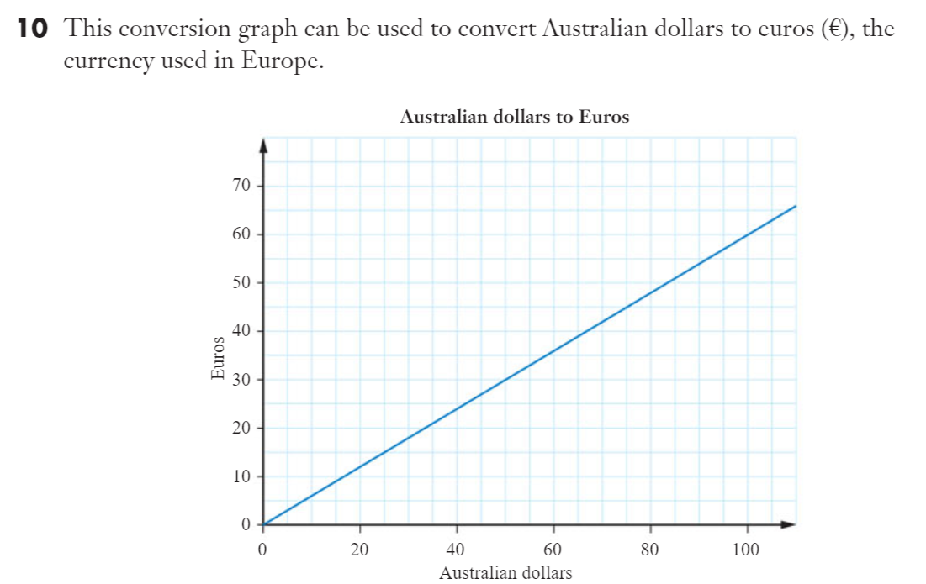

Slide 11
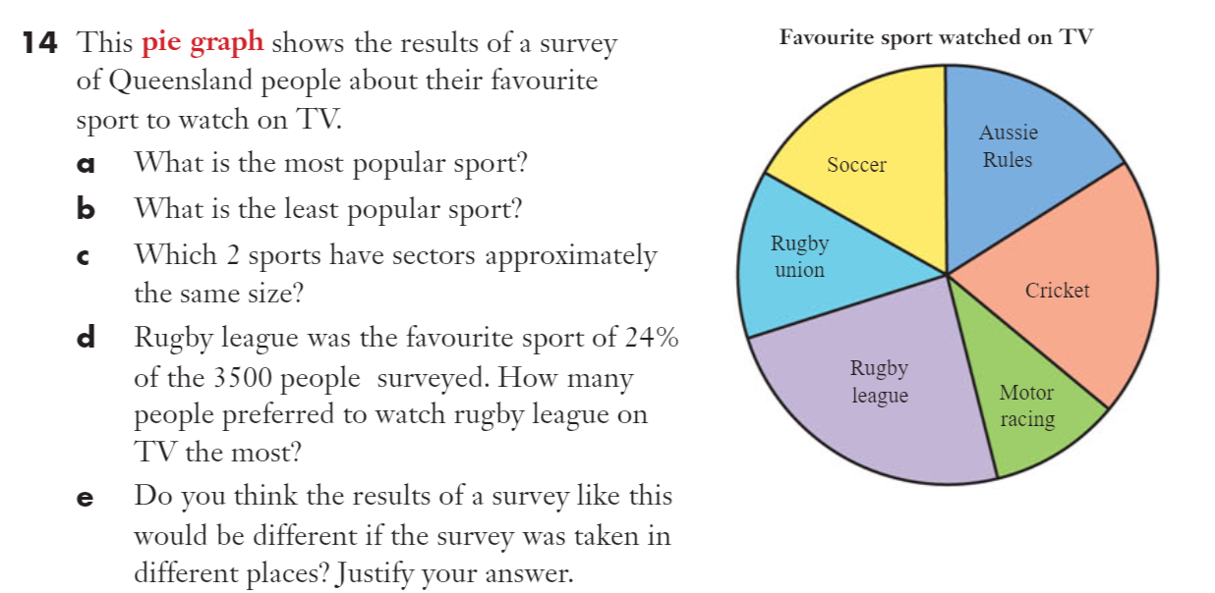

Slide 12
Week 5 – lesson 4

